Slide 1
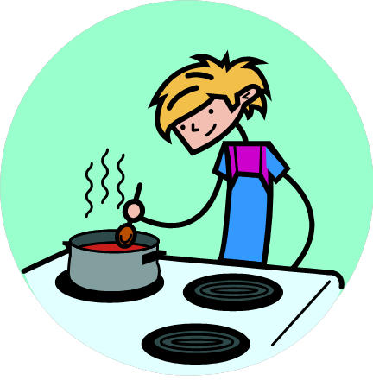
Food Safety at the Foodstand
For Additional Information Contact:
Karen Blakeslee, Extension Associate, Rapid Response Center Coordinator, kblakesl@ksu.edu
Dr. Londa Nwadike, Assistant Professor, Extension Food Safety. lnwadike@ksu.edu
Gayle Price, Extension Specialist, Family and Consumer Sciences, SE Area, gprice@ksu.edu
Original presentation created by Denise Sullivan past Extension Agent-Family and Consumer Sciences, Leavenworth County

Slide 2
Kids Keeping Food Stands Safe
An Interactive Module for Temporary Youth Food Stand Workers
Module designed by Bridget Curley, Former Program Assistant,
Julie Garden-Robinson, Food and Nutrition Specialist;
revised in 2014 by Kimberly Beauchamp, Food Safety/Food Entrepreneur Extension Specialist

Slide 3
How to work though this program
Click the left mouse button (or the down arrow )to go to the next bullet or slide.
Before you go through the module, a new window will open, and you’ll answer some survey questions.
When you are finished with the survey questions, close the window to return to the slides in this program module.

Slide 4
When you see this symbol ,
click your mouse once to see answer.
When you see this symbol,
“stop and think” of the answer. Then, click your mouse to see the answer.

Slide 5
Near the end of the module, you will take a second survey.
  The second survey will open in a new window.
  When you are finished with the survey, close the window to return to the program module.

Slide 6
It’s Time to Take the Pre-Survey
Click here to begin the survey.
You’ll return this module when you are done with the pre-survey.

Slide 7
Serving food to the public can be a fun experience
Remember:
  Personal safety and food safety come first.
  Be careful when working, and keep a clean workplace.

Slide 8
Question Time
Working at a temporary food stand should be:
  Fun
  Boring
  Unenjoyable
    Click to see answer
The answer is a. We hope the experience is enjoyable for those who have the chance to help out.

Slide 9
Food Safety-It’s a Big Deal
Annual estimates from CDC
  48 million cases of food borne illness
  128,000 hospitalizations
  3000 deaths
  $77 billion annual cost
Food Borne Illness (FBI) is a serious public health threat

Slide 10
Food Borne Illness:
Who’s at Risk
Infants
Young children
Pregnant women
Older adults
People with weakened immune systems

Slide 11
How Does FBI Occur
Three types of microbial contaminants
  Physical
  Chemical
    Including natural plant or fish toxins
  Biological
    Bacteria
    Viruses
    Parasites
    Fungi
      Yeasts
      Molds
Theses are all known as ‘microbes’
  Present in food at purchase
  Introduced by other products or people

Slide 12
What do Microbes Need to Grow?
Food
Acid
Time
Temperature
Oxygen
Moisture

Slide 13
  Be careful when working with “potentially hazardous” foods.
    These are foods that may become contaminated if not stored or cooked properly.
  Examples of “potentially hazardous” foods:
Sandwiches made with meat
Poultry
Fish
Salads
Meat
Egg products
Milk

Slide 14
You are responsible for identifying “potentially hazardous” foods.
Click below to reveal the “potentially hazardous” foods.
Potentially
Hazardous
Potentially
Hazardous
Potentially
Hazardous

Slide 15

Keep your work area clean and free of germs
  A clean area helps reduce the risk of spreading “germs” such as bacteria, into food.
Germs can contaminate the food.
People can get very sick from eating contaminated food.

Slide 16
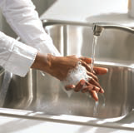
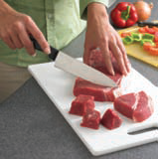
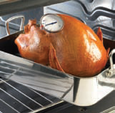
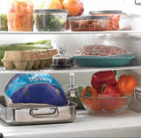
What are the Four Steps to Food Safety?
CLEAN
SEPARATE
COOK
CHILL
When people get an illness from eating contaminated food, it is because something probably went wrong in one of these areas.

Slide 17
True or False
True or False
The important food safety areas to remember are clean, separate, cook and chill.
Click to see the answer

Slide 18


Slide 19
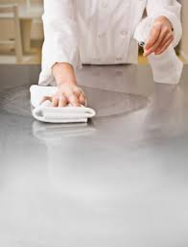
Cleaning and Sanitizing
Keep work areas, equipment and dishes clean and sanitized.
  “Sanitized” means you have used a sanitizer such as a bleach-water rinse, after cleaning.
Cleaning gets rid of what you CAN see
Sanitizing gets rid of what you CAN’T see

Slide 20
Clean surfaces such as counters and tables by wiping them with paper towels and sanitizer solution.
Homemade sanitizer solutions can be made by mixing 1 tablespoon of chlorine bleach with 1 gallon of water.
Do not use sponges or cloth towels to clean up spills.

Slide 21
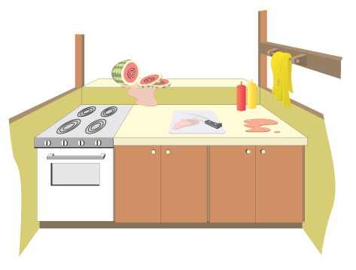
Inspect areas where food is prepared, eaten and served and identify areas that need to be cleaned
Click to see the three areas that need cleaning in this picture
Dirty
Dirty
Dirty

Slide 22
Keeping it Clean
A Homemade sanitizer solution can be created from ___________?
  1 cup of water and 1 tablespoon of chlorine bleach.
  1 gallon of water and 1 tablespoon of chlorine bleach
  1 quart of water and 3 tablespoons of chlorine bleach.
Click to reveal answer

Slide 23
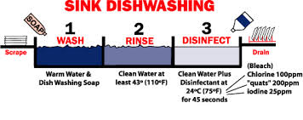
Cleaning dishes
Scrape off excess food before washing dishes
#1) Wash dishes with warm, soapy water.
#2) Rinse off the soap with hot water.
#3) Next, rinse with the sanitizing solution.
  Sanitizing reduces the amount of germs on each item.
  Just because something looks clean does not mean it is sanitized or safe to use.
#4) Allow dishes to air dry.
  Dishtowels can spread bacteria from dish to dish.

Slide 24
You have been assigned to help wash dishes. What is the correct order to clean dishes and utensils properly?
Click and the correct order will appear.
Sanitize
Scrape
Air dry
Rinse
Wash

Slide 25
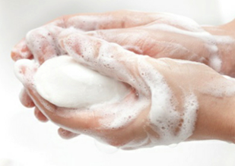
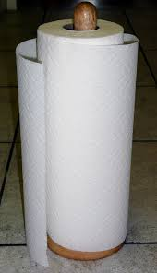
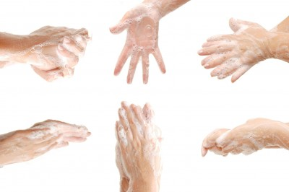
Volunteer Health and Hygiene
Wash your hands before starting work and often during your shift.
Wash hands in warm, soapy water for at least 20 seconds.
Dry them using a paper towel and throw the towel in the garbage.
Use hand antiseptics after not instead of handwashing.

Slide 26
20 Seconds…
Is that a long time? How do you know when the 20 seconds are up?
  Sing “Twinkle, Twinkle, Little Star”
  Slowly count 20 Mississippis
  Hum the “ABC” song to yourself
  All are good ideas
Click to reveal answer
Using any of these ideas while washing your hands will help you wash them long enough to get them clean!

Slide 27

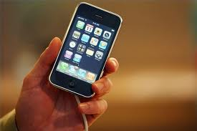
Always Wash Your Hands:
… Before touching food or clean surfaces
… After you touch food
… If you touch your face, touch your eyes,
touch your hair, blow your nose, take out
garbage or go to the bathroom
… If you handle money
  Money is covered in germs.
  If you touch money while wearing gloves,
  wash your hands and re-glove before touching food.
… If you use your phone
  Cell phones are covered in germs.
  If you use your phone, wash your hands
before touching food or clean surfaces.

Slide 28
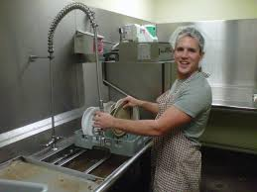
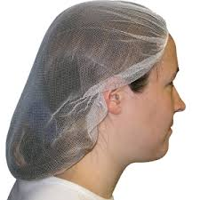
Keep Neat and Clean!
Before starting your shift, have
a clean appearance, a clean shirt
and a clean apron to keep your
clothes from becoming dirty.
If you have long hair, tie it back
Wearing a hair restraint isn’t required but is a good idea to keep hair out of food.

Slide 29
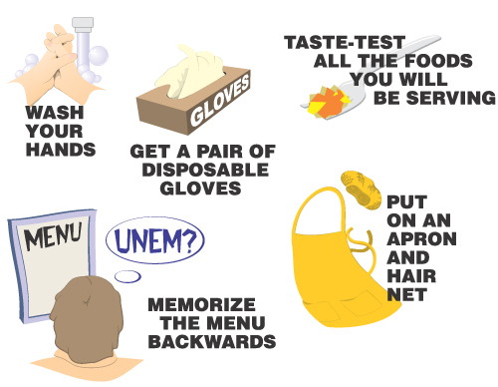
You are about to start your shift.
Which of the following should you do before starting?
Click to reveal answer.
Not Important
Not Important

Slide 30
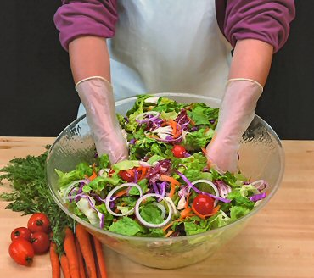
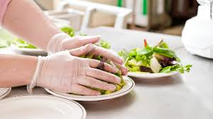
Glove Safety
Everyone should wear disposable
gloves when handling ready-to-
eat-food.
Be sure to put on new gloves,
after washing your hands.
Change gloves, if they become
dirty or torn, or if you switch tasks.
  For example, if you are serving nachos and then switch to serving burgers, change your gloves to prevent cross contamination.

Slide 31


Slide 32
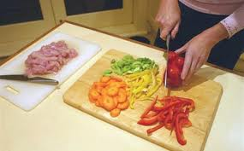
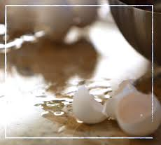
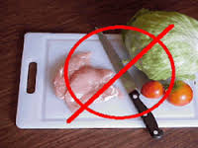
Contamination and Foodborne Illness
Separate foods, to reduce the risk of transferring germs from one food to another.
        Foods can pick up germs if
        it touches a surface that has
        not been cleaned and
        sanitized properly.
Never allow raw food
to come in contact with
cooked or ready-to-serve food.

Slide 33
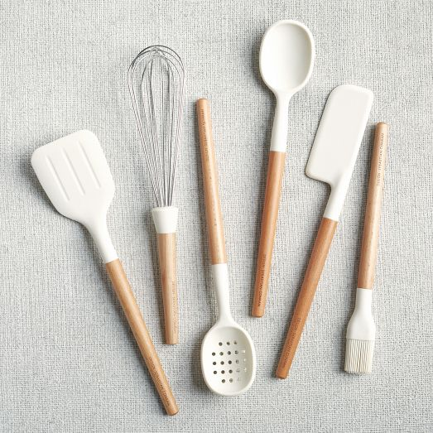
Serving Utensil Use
Before starting your shift, have
the correct supplies available.
Have serving utensils, such as
tongs, ladles and scoops, ready
so you minimize your food contact.
Have enough utensils available for each different food.
  For example, you do not want to use the hot dog tongs to grab a cookie.

Slide 34

If you need to touch food,
only do so wearing clean
disposable gloves.
When filling cup, plate and napkin dispensers, fill from the back or bottom so all products are used in the order you fill them.

Slide 35
Match the following foods with the proper serving utensils :
Click and the correct answers will appear
1. Hot dog a. Gloved hand
2. Mashed potatoes b. Ladle
3. Soup c. Scoop
4. Nacho chips d. Tongs
1. Hot dog d. Tongs
2. Mashed potatoes c. Scoop
3. Soup b. Ladle
4. Nacho chips a. Gloved hand

Slide 36
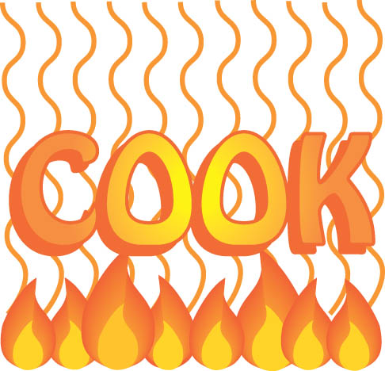

Slide 37
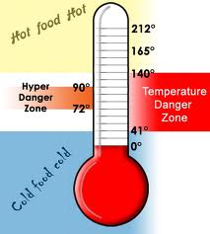
Preparing, cooking and serving food
Keep the temperature “danger zone” in mind.
  Danger Zone = Temperatures between 41 F and 135 F.
At these temperatures, germs and bacteria can grow quickly.
An adult should check foods with a thermometer frequently to ensure that temperatures are safe.

Slide 38
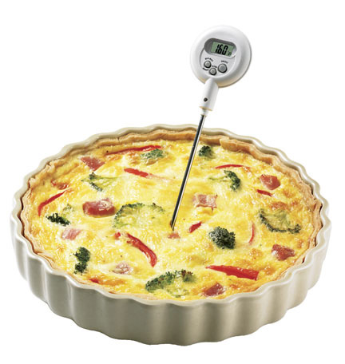
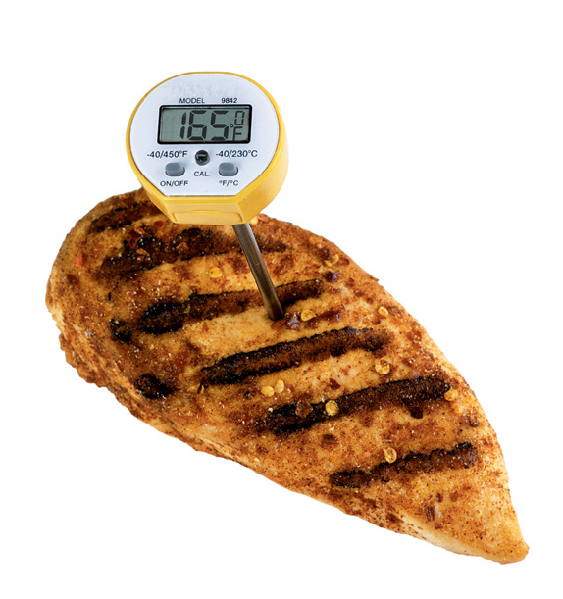
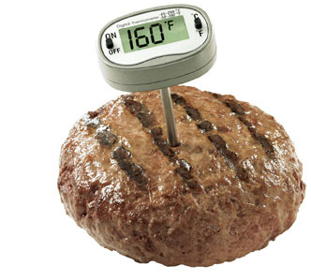

You noticed some of the equipment is not heating foods correctly.
Pick out the foods in the temperature danger zone.
Click to see the answer.
Poultry should be heated to 165F not 65F

Slide 39
Serving Customers
Food should be served to customers with disposable dishes, such as paper plates, Styrofoam cups and plastic silverware.
When handing plates, cups or silverware to customers, never touch the part that will come in contact with food or the person’s mouth.
If customers ask you to carry items for them, take only what you can handle.

Slide 40


You have to serve food to customers
Click to reveal the portion of these objects that you should touch while passing food to customers.

Slide 41
Before You Start
Ask for instructions, if you are uncertain of the area or the station you will be working in.
  Are you feeling unsure of the area?
  Are you feeling unfamiliar with the station?
  Do you feel a lack experience with the equipment?
  Ask an adult before starting.

Slide 42


Slide 43
Storing Food
Store food in appropriate containers so the food is safe for later use.
Use shallow containers to store food in refrigerator.
  Thick foods, such as sloppy joe meat or chili, should be chilled in a container no more than 2 inches deep.
  Other foods, such as a thin soup, can be stored 3 inches deep.

Slide 44
True or False
True or False
The shallower the food level, the quicker it will chill to a safe temperature.
Click to see the answer.

Slide 45
Label Containers
Cover food with a lid or plastic wrap before putting it away.
Label the container with the date, time and what is in it.
  This allows the next person to identify the contents without taking it out and uncovering it.
  Writing the date and time lets people know when the food was prepared and how long it is safe to use.

Slide 46
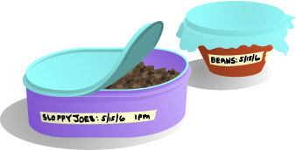
Which containers are labeled correctly?
Click to see the answer.
A.
A. The date and contents are both listed
B.

Slide 47
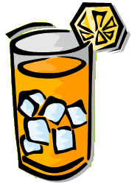
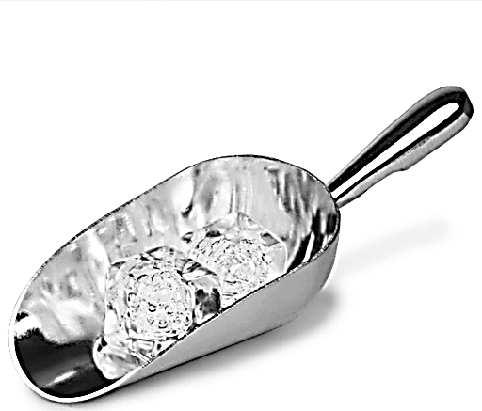
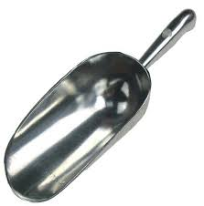
Ice Safety
Food safety also applies to ice served in drinks.
Remember, ice touches the liquids that customers will drink.
Do not touch the ice with your hands, or scoop the ice with a cup.
Use a metal scoop when adding ice to drinking cups or ice coolers.

Slide 48
Stay Safe While Working
Do not lift heavy objects by yourself. Get help!
Be extra careful when working with sharp objects, such as knives.
Be careful around stoves and other hot equipment.
Keep the floors clean and clear of objects so you don’t trip over anything.
Clean up spills to avoid slipping.

Slide 49
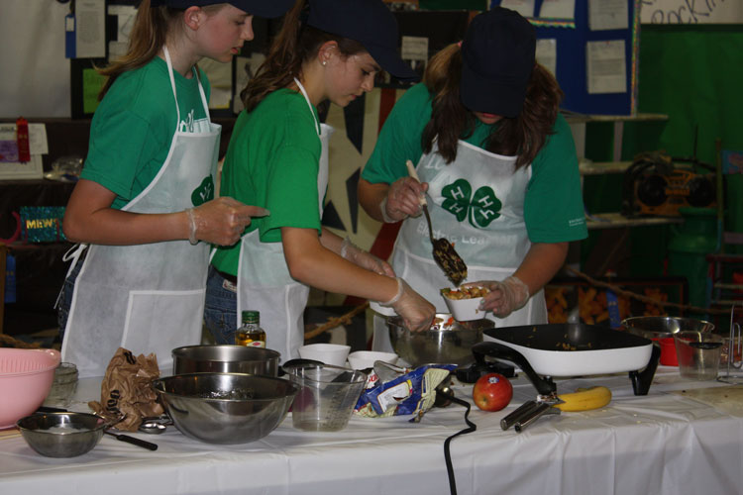
Food Safety is in YOUR Hands!

Slide 50
Time to Take the Post-survey
After completing all the activities and review questions, you are ready to take the survey! Good luck!
Click here to begin post-survey!

Slide 51
Helpful Resources
K-State Research & Extension Food Safety
KS Dept of Agriculture - Focus on Food Safety
Partnership for Food Safety Education

Slide 52


Leavenworth County Extension Office
613 Holiday Plaza
Lansing, KS 66048
916-364-5700
www.leavenworth.ksu.edu
K-State Research & Extension is an equal opportunity institution.

